Slide 1
Live streaming platform- Progress Report
B11102015 Bingxiu Yu, B11102112 Chiajui Lee, B11102213 Guojun Zeng

Slide 2
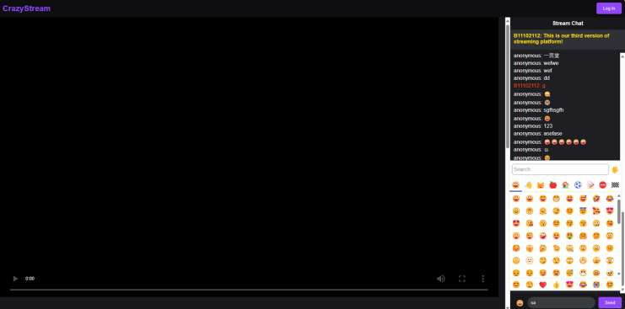
Main page

Slide 3
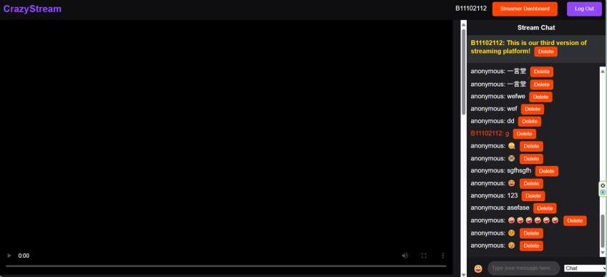
After login page

Slide 4
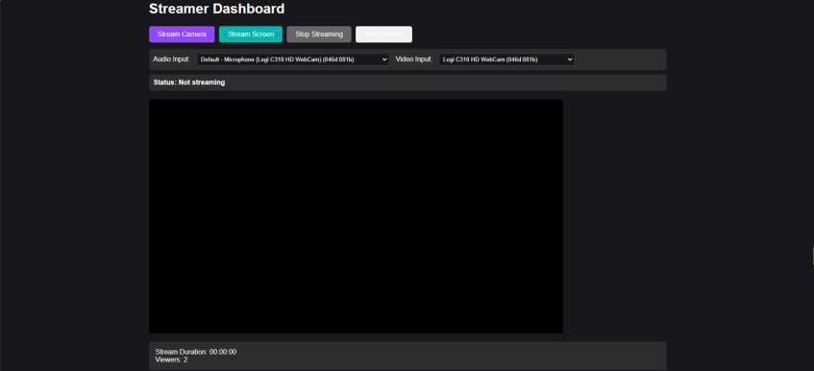
Streamer dashboard

Slide 5
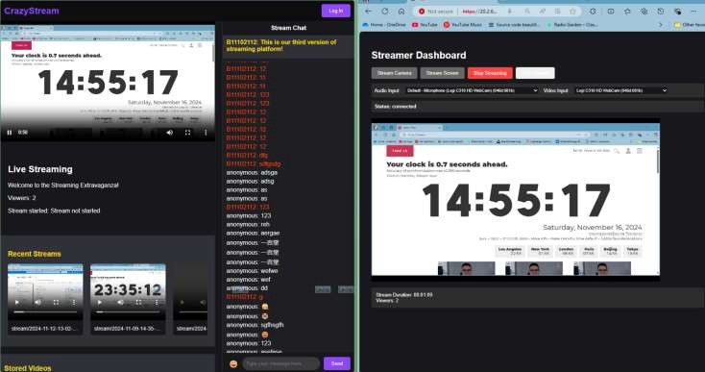
Streamer dashboard( with streaming)

Slide 6
Obstacle
Technology Migration: Initially implemented with RTMP (Real-Time Messaging Protocol), but observed latency exceeding 10 seconds, prompting a switch to WebRTC (Web Real-Time Communication) for sub-500ms low-latency streaming.

